Slide 1
Introduction to Web Design and Applications APT 1040
LECTURE 4 A
By Bernard Ondiek

Slide 2
Introduction to Web Design and Applications APT 1040
LECTURE 8- forms
By Bernard Ondiek

Slide 3
Creating Web Page Forms

Slide 4
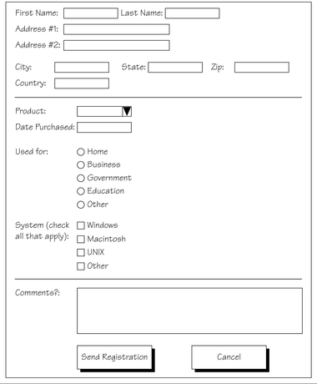
An Example of a Form

Slide 5
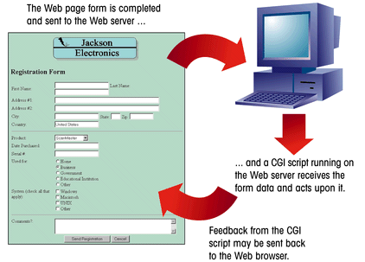
The Interaction between a Web Page Form and a CGI Script
This figure shows how a Web page form interacts with a CGI script.

Slide 6
Working with CGI Scripts
HTML supports tags for creating forms, however, it does not process the information.
Use CGI (Common Gateway Interface) script to process form information.
CGI script runs on the Web server and receives data from a form and uses it to perform a set of tasks.
Web page designers may not be able to create or edit CGI scripts.
Internet Service Providers (ISPs) and universities may provide CGI scripts that their customers and student can use on their Web sites, but which they cannot directly access or modify

Slide 7
CGI Scripts and Computer Languages
CGI scripts can be written in a variety of different computer languages. Some of the most commonly used languages are:
AppleScript
ASP
C/C++
Perl
TCL
The UNIX shell
Visual Basic
The computer language used depends on the Web server.

Slide 8
Form Components and Elements
Input box
First Name
Last Name
Address #1
Address #2
City
State
Zip
Country
Item Purchased
Purchase Date
drop-down list box
Serial Number
group box
Used For (check one)
Network Operating System (check all that apply)
Home
Netware
Business
Banyan Vines
radio buttons
Religious or Charitable Institution
Windows
Government
IBM Lan Server
check boxes
Educational Institution
PC/NFS
Comments?:
text area
Send Registration
Cancel
form button

Slide 9
Form Control Elements
Control elements :
text boxes for text and numerical entries
selection lists for long lists of options, usually appearing in a drop-down list box
radio buttons, also called option buttons, to select a single option from a predefined list
check boxes to specify an item as either present or absent
groups boxes to organize form elements
text areas for extended entries that can include several lines of text
buttons that can be clicked to start processing the form
Each control element in which the user can enter information is called a field.

Slide 10
The <form> Tag
A single page can include several different forms, but you cannot nest one form inside another.
The general syntax of the <form> tag is:
<form attributes>
form elements and layout tags
</form>
A single Web page can contain multiple forms, the <form> tag includes the name attribute.
The name attribute identifies each form on the page.
The name attribute is also needed for programs that retrieve values from the form.

Slide 11


Adding the <form> Tag
The <form> tag includes attributes that control how the form is processed, including information on what CGI script to use, how the data is to be transferred to the script, and so forth.
This figure shows the form name “reg.”

Slide 12
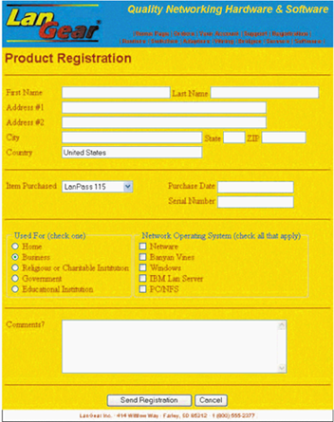
Completed Registration Form
contact information
product information
usage information
comments
buttons

Slide 13
Input Types

Slide 14
Working with Text Boxes
Text boxes are created using the <input> tag.
The general syntax is:
<input type=“type” name=“name” id=“id”>
type specifies the type of input field
name and id attributes identifies the input field for the CGI script
To create a text box, you would enter the tag:
<input type=“text”>

Slide 15
LAB1:Testing Controls
Enter FirstName:<input type=“text” name=“fname”><br>
Enter LastName:<input type=“text” name=“lname”><br>
Enter Password:<input type=“password” name=“pass”><br>

Slide 16
Radio Button
Gender<br>
<input type="radio" name="Gender" value="male" checked> Male <br>
<input type="radio" name="Gender" value="Female" checked> Female <br>
<input type="radio" name="Gender" value="Other" checked> Other <br>

Slide 17
Checkbox
City<br>
<input type="checkbox" name="city" value="nairobi">Nairobi <br>
<input type="checkbox" name="city" value="mombasa">mombasa<br>
<input type="checkbox" name="city" value="kisumu">Kisumu<br>

Slide 18
Listbox
Status<br>
<select>
<option value="Married">Married</option>
<option value="Single">Single</option>
<option value="Divorced">Divorced</option>
</select>

Slide 19
Text area
<br> More information
<textarea rows=“5” cols=“20”>
</textarea>

Slide 20
Buttons
<input type="submit" name="send“ value=“TUMA”>&nbsp &nbsp &nbsp
<input type="reset" name="cancel“ value=“SAHIHISHA”>

Slide 21
Q & A

